Slide 1


Accessibility: The Road to Success
February 19 – 21, 2019

Slide 2
Digital Access and YOU
ILCCO Growing Online Learning Conference
February 21, 2019
Notes:
M
Students are more likely to succeed when they have timely access to content in formats that suit their needs.
Adapts to learning preferences and knowledge acquisition
Social Justice issue - Students with disabilities historically excluded from higher learning and society as a whole.
Slides will be shared to you by the training committee
High impact practices that are easy to perform in the MS Office products you and your patrons use every day.

Slide 3
Learning Technologies
Remediation
Blackboard Ally
General course and content questions
UDL Consulting
Course and content review (Let US take a look!!)
Vetting/inclusive technology selection/identification
Blackboard accommodations
Recommended technology
Notes:
M

Slide 4
Accessibility is a Social Justice Issue
Students with disabilities historically excluded from society as well as higher learning
Reduces stigmatization of difference
Disability is diversity
Accessibility is inclusion
Notes:
B

Slide 5
Contributions to Student Success
All students receive content that leads to course success
Adapts to learning preferences and knowledge acquisition
  Universal Design of Learning
  Multimodality
    Visual vs. reading/writing vs. auditory vs. kinesthetic, etc.
ELA student comprehension
Notes:
M

Slide 6
Improving Content Availability
The impact of responsive design
Adapts to all devices
  Desktop computers
  Laptops
  Tablets
  Phones
  Assistive technology
Goes along with students to where and how students learn best
  85% Facebook videos watched without sound
Usage of multiple devices
Notes:
B

Slide 7
Accessibility vs. Accommodations
Proactive instead of reactive
Inclusive rather than compliant
Serve populations instead of individuals
Assists in streamlining student work flows
  Reduces the wait time for converted formats
Resource: Dos and dont’s on designing for accessibility
Video - The Importance of Accessible Materials in Higher Education
Notes:
M

Slide 8
Accessible Content Starting Points
Use Native File Formats (docx, pptx, etc) pdf
Define Headings and Styles
Design for Readability
Create Descriptive Links
Provide Alternate Text
Use Colors Effectively
Caption Video Files
Utilize Accessibility Checkers for Remediation
Notes:
B
What we'll be going over in this presentation as the starting points for making content accessible.
No groundbreaking or hidden tools. These are all readily available in Microsoft Office and relate to Word, Outlook, PowerPoint, etc.
All contribute to ALL students being able to get the most out of your content no matter what technology they are using
Desktop
Assistive tech
Mobile
Note: when you're remediating documents, start with Office's Accessibility Checker to guide you through the remediation process.

Slide 9
Use Native File Formats (.docx, .xlsx, .pptx)
Keeping the original format allows users to adjust content to their needs:
  Alternate formats
  Formatting
  Font sizes
  Line spaces
  Readability
Converting to PDF removes or minimizes file accessibility
  Students cannot replace the original file on your LMS
  or other sites!
NCDAE Cheatsheets
Notes:
M
The impact of responsive design
Adapts to all devices and user contexts
Desktop computers
Laptops
Tablets
Phones
Assistive technology
Usage on multiple devices and contexts
Who here has ever opened a PDF on their phone and, while reading had to keep scrolling to the right and left to read the document?

Slide 10
If you must save as a PDF…..
The native file must be exported correctly to maintain as much accessibility as possible. Look for an option to save for web and/or as a "tagged PDF".
  In Word, save as PDF and choose Optimize for Web. If a file is created by printing to PDF, it will not be correctly tagged.
  In other Office programs, save as PDF and tick Document structure tags for accessibility check in Options.
  Note: Users must have either Acrobat or the Microsoft PDF add-in installed to properly save the PDF.
  PDF Conversion In Microsoft Word Documents
Notes:
B

Slide 11
Define Headings and Styles
Establishes the document outline and organizes your content semantically for ease of navigation, visual scanning, and readability.
Utilizing built-in headings and styles logically and consistently improves content readability.
Notes:
M

Slide 12
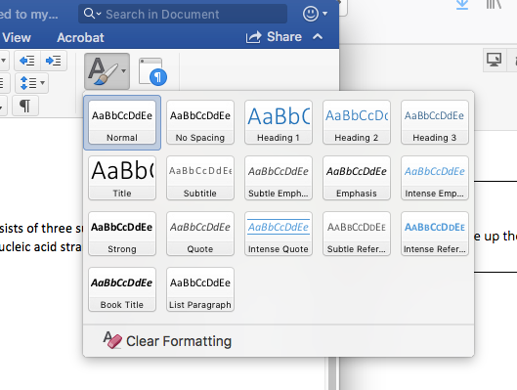
Try It Out – Defining Headings and Styles
In Word, use the Styles feature to add headings. You can use the default styles, or you can modify them to change your design. Styles are accessed from the Home tab:
To add a heading to text, position your cursor anywhere in the line of text you want to affect. In the Styles menu, choose one of the Heading styles.
Tips
Begin with Heading Level 1 rather than skipping to a lower level.
Don't use heading styles for cosmetic changes to your text; save them for structural information.
Customizing Heading Styles in Word – Penn State Accessibility
Notes:
M

Slide 13
Design for Readability
Readability describes "the optimum arrangement and layout of whole bodies of text" for ease and enjoyment of reading.
Use native style functionality
Use easily legible fonts. Sans serif fonts (e.g., Arial, Helvetica, Verdana) are recommended.
Line spacing is just as important as font size. Line spacing of at least 150%, or 1.5, in paragraphs is recommended. (W3C)
Notes:
B
Benefit more users from the outset (fewer users spending time adjusting your content)
To meet W3C accessibility guidelines “Line spacing is at least space-and-a-half within paragraphs—that’s 150%.”
_________________
http://alexpoole.info/blog/which-are-more-legible-serif-or-sans-serif-typefaces/

Slide 14
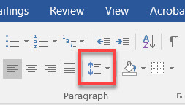
Try It Out – Designing for Readability
To change the line spacing,
  Highlight your text and click Line and Paragraph spacing.
  Select the spacing you want (at least 1.5)
Notes:
B

Slide 15
Ordered and Unordered Lists
Tips:
Don't emulate lists using tabs, spaces, or special characters.
Do use the built-in list functionality.
When creating multilevel (nested) lists, use different letters and numbers for the various levels.
Notes:
M

Slide 16
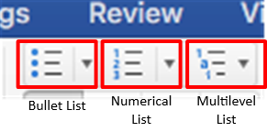
Try It Out
To create a list in Word,
Position the cursor where you want to insert the list or highlight the text to turn into a list.
On the Home tab, choose what kind of list you want to make.
GCFGlobal - Working with Lists
Notes:
M

Slide 17
Create Descriptive Links
Which hyperlink includes more context and is easier to understand?
https://www.google.com/search?q=ilcco&rlz=1C1GCEB_enUS824US824&oq=ilcco&aqs=chrome..69i57j0l5.3580j0j1&sourceid=chrome&ie=UTF-8
VS
Google search for ILCCO
Use context to where the link will take the user.
Avoid "Click here" and general language
Notes:
B

Slide 18
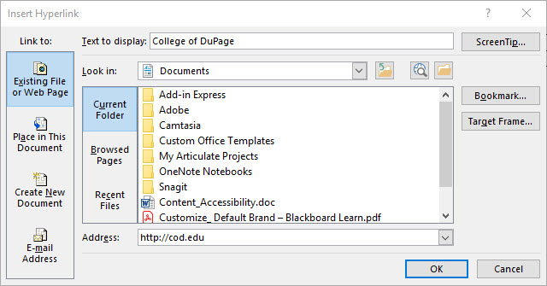
Creating Hyperlinks
Accessible U – Hyperlinks – University of Minnesota
Notes:
B

Slide 19
Provide Alt-Text
Describe an image, photograph, chart or any other graphic
Helps in understanding what’s on a page
Describes images that don't load on screen
Alt-Text for web pages and Microsoft Office files
Image captions benefit all users
Notes:
M
Highlight relevance and examples of emails....since alt-text applies to those too.

Slide 20
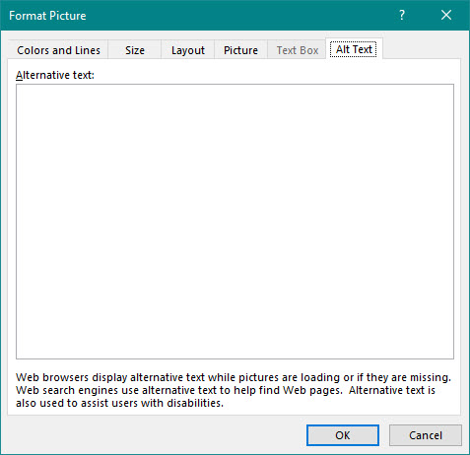
Adding Alt-Text to documents
Alt Text – Accessible U - University of Minnesota
Alternative text should be added to every image that conveys meaning in instructional and communications materials including LMS sites and the Office suite.
Notes:
M

Slide 21
Using Colors Effectively
4.5% of the global population experience color blindness
  1 in 12 men and 1 in 200 women
4% have low vision (1 in 30 people)
0.6% are blind (1 in 188 people)
Avoid using color as the only visual mean of conveying information
Use textures instead of color to make graphs easy to understand
Colour Blind Awareness
Notes:
B

Slide 22
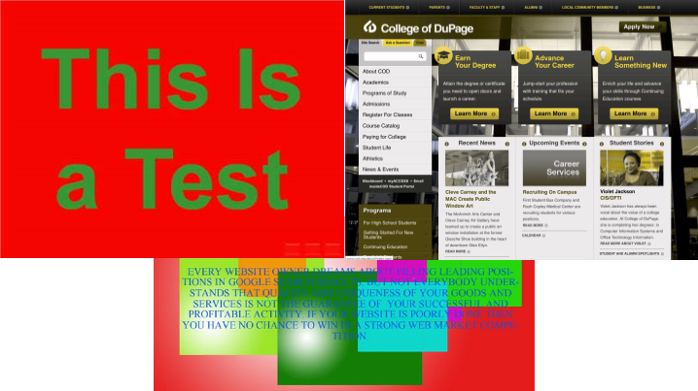
Examples of improper use of colors
Notes:
B

Slide 23
Effective Color Resources
Colour Blind Awareness
Provides statistics and examples of the different forms of color blindness.
WebAIM Color Contrast Checker
Enter a foreground and background color, or choose a color using the color picker and the tool will display whether you pass or fail WCAG accessibility.
The Colour Contrast Analyser (CCA)
Helps you determine the legibility of text and the contrast of visual elements, such as graphical controls and visual indicators. Also includes a color blindness simulator.
Let’s get color blind – Firefox browser extension
Simulates information a color blind person receives and/or adds a daltonization filter. This addon can be used for testing a website accessibility for the color blind and / or to educate (yourself) on the topic of color blindness.
Notes:
B

Slide 24
Utilize Accessibility Checkers
Microsoft Office
Before sending your email message or sharing your document or spreadsheet, run Accessibility Checker to make sure your content is easy for people of all abilities to read and edit.
Blackboard Ally
Evaluates course content in Blackboard for accessibility and provides alternative formats to students (MP3, tagged PDF, ePub, HTML, and electronic Braille).
Accessibility tools
  A11Y Evaluators – WAVE, Axe, Color Contrast Analyzer, JAWS Inspect
  Simulators: Colorblinding, WebAIM
Notes:
M
__________________
https://webaim.org/resources/

Slide 25

Blackboard Ally
Campus wide initiative emphasizing the importance of accessibility and UDL.
  Faculty receive feedback on the accessibility of their course content in Blackboard.
  Students can leverage alternative formats such as mp3, ePub, HTML, tagged PDF, electronic Braille.
  Spring pilot with campus wide rollout for summer and fall semesters.
Blackboard Ally Overview Video
Notes:
M

Slide 26
Caption Video Files
Over 28 million American adults are deaf or hard of hearing
85% of Facebook videos are watched on mute
Captions improve comprehension
91% of videos with captions are watched to completion
66% of videos without captions are watched to completion
7 Reasons Your Videos Need Subtitles [Infographic]
Notes:
B

Slide 27
Video Caption Resources
Creating Accessible Content: Videos
Video content can be an excellent way to enrich your course, but visual and auditory disabilities can make it difficult for some students to benefit. Luckily, making videos fully accessible is both fairly straightforward and easy to find assistance with (we can help).
Captioning YouTube Videos
The National Center on Disability and Access to Education provides step by step resources on captioning videos in YouTube.
Captioning YouTube Videos (PDF)
One Page PDF guide from the National Center on Disability and Access to Education.
How to Caption YouTube Videos – Video walkthrough
Notes:
B

Slide 28
Video
Online Accessibility -
How to Help All Your Students Out of the Classroom

Slide 29

Conference Archives
Recordings of these presentations will be available at:
ILCCO Website
under Resources & Events
For more information about ILCCO:
jeff.newell@illinois.gov

